Slide 1

Final Project: Laptop Price Prediction
Group name: Group Beta
Members: Likhitha Varakala Manmitha Pantangi
Vrushali Ransubhe
Aybuke Korkan Yilmaz Class Number: ALY6015 Class Name: Intermediate Analytics
Class CRN: 20419
Email: varakala.l@northeastern.edu
pantangi.m@northeastern.edu
ransubhe.v@northeastern.edu
korkanyilmaz.a@northeastern.edu

Slide 2
Assignment Summary
The dataset called 'Laptop Price Prediction' is obtained from Kaggle.
It includes columns for the Company, Type of Laptop, Inches, RAM, Memory, Operating System, GPU, weight, and Price—all elements that affect a laptop's price.
The data consists of 1303 rows and 14 variables.
We will evaluate different models to ascertain which one is most accurate in making predictions.
To determine what factors, affect the price of a laptop.

Slide 3
Models used
Multiple Linear Regression
Ridge Regression
Lasso Regression
Why use an alternative fitting procedure?
To improve,
Prediction Accuracy
Model Interpretability

Slide 4
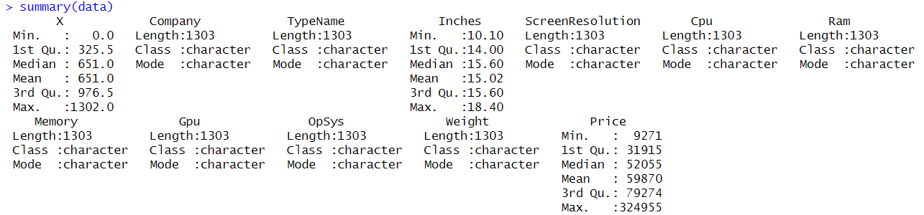
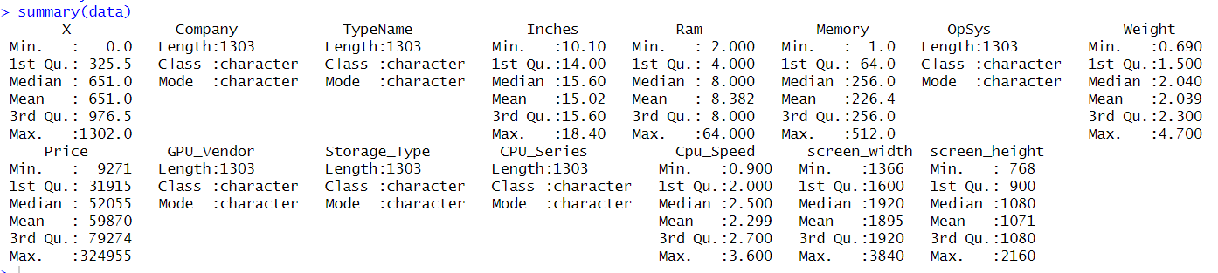
Summary of the dataset
Before cleaning,
After cleaning,

Slide 5
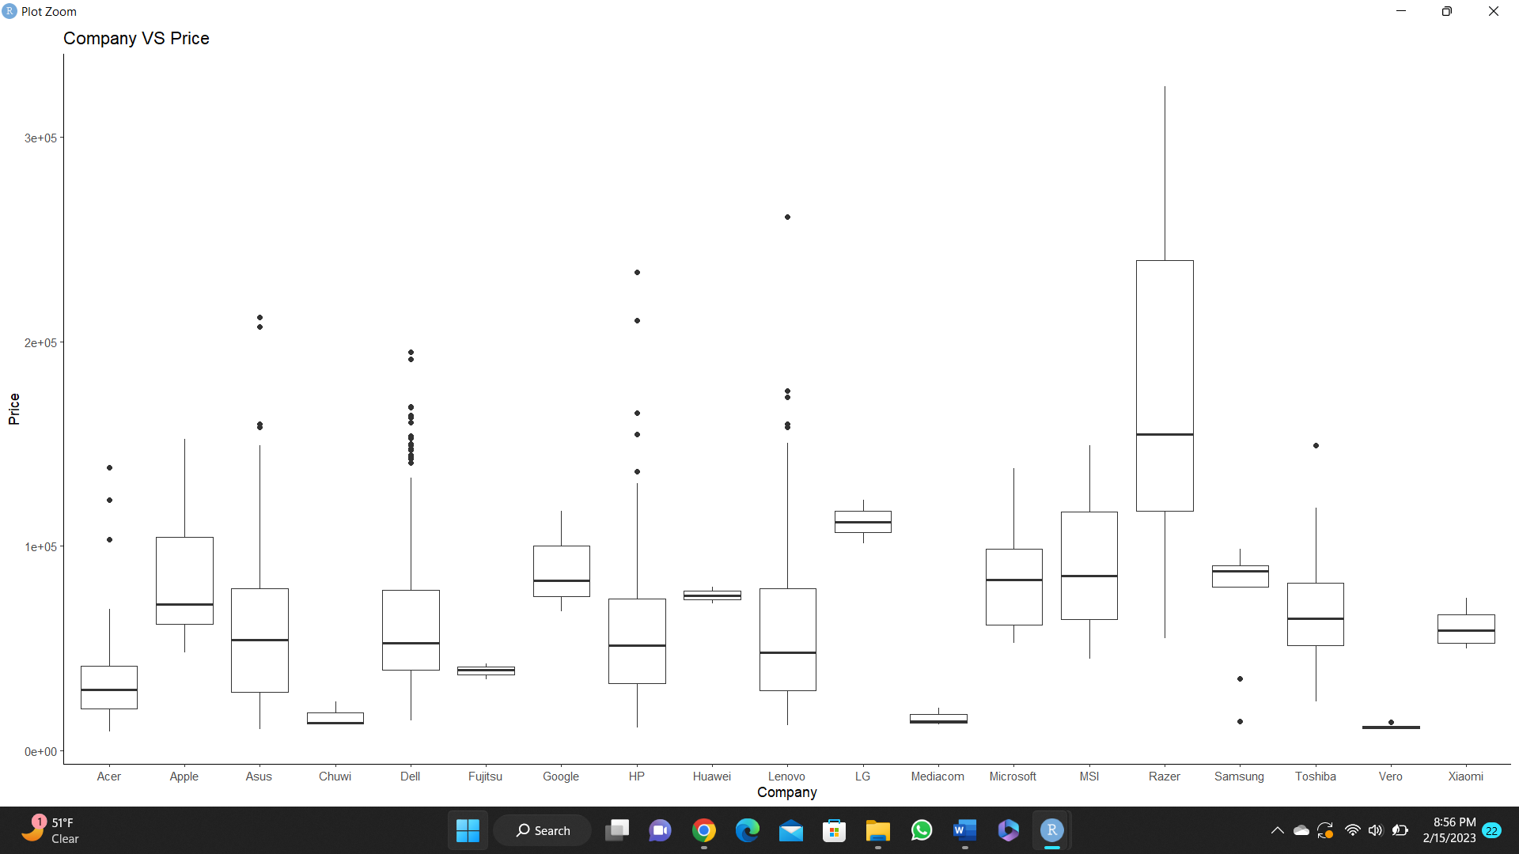
Company vs Price
Based on the boxplot, it can be observed that Razer laptops have the highest mean prices compared to other brands. Therefore, it can be concluded that laptops from the Razer brand are the most expensive among the others.

Slide 6
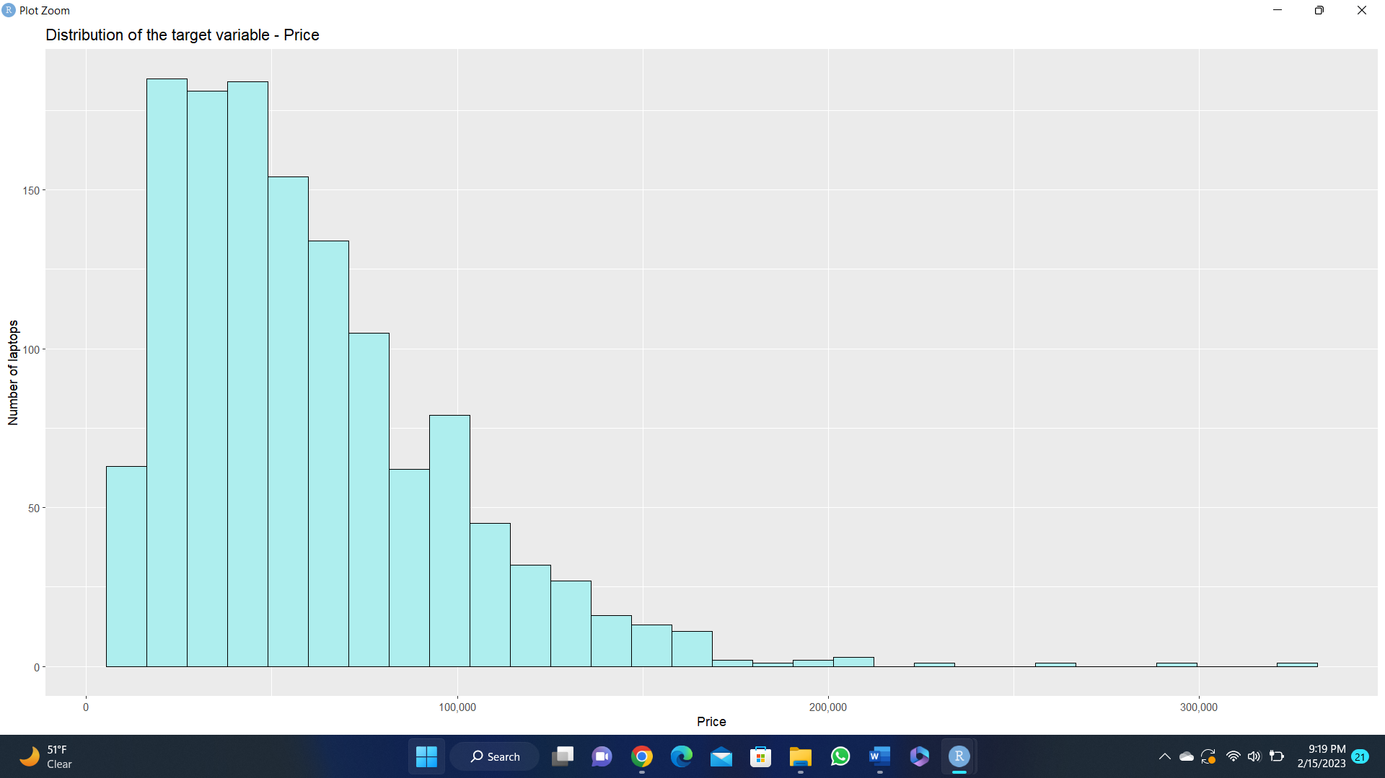
Distribution of Price
The "price" variable's distribution is skewed, making it clear that cheaper laptops like those from Dell and Lenovo are sold and bought more frequently than name-brand models.

Slide 7
Multiple Linear Regression
Multiple linear regression, also known as multiple regression, is a statistical technique that uses several independent variables to predict the outcome of a dependent variable.

Slide 8
What can we learn from MLR?
How strong the relationship is between two or more independent variables
The value of the dependent variable at a certain value of the independent variables
Companies could have an idea about long-term outlook, it can be used for research predictions.

Slide 9
Steps to Perform Multiple Linear Regression
Show the correlations with visual help
Split train and test data
Create a linear regression model
Make predictions on the test dataset
Finding Accuracy for test data

Slide 10
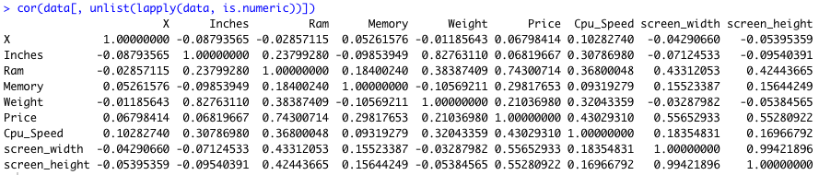
Correlation Between Variables

Slide 11
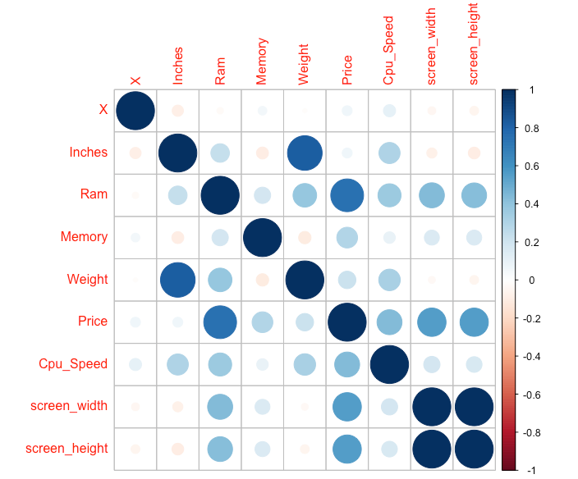
Correlation Plot

Slide 12
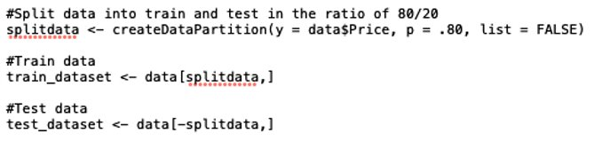
Splitting Train and Test dataset
We should split dataset as train and test dataset to evaluate how well our machine learning model performs. We used 80/20 ratio here, which is the most common ratio for splitting datasets. Train set is used to fit the model, statistics of train set is known. Test dataset used for predictions.

Slide 13
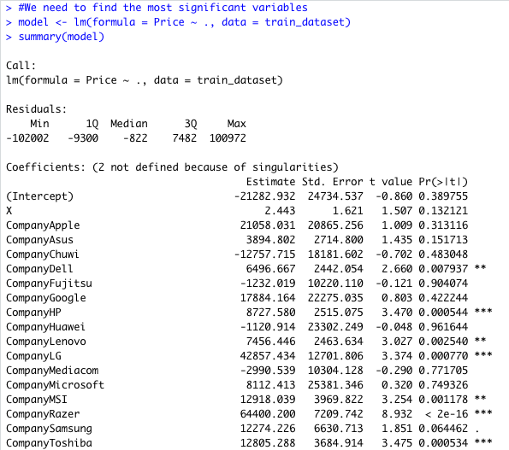
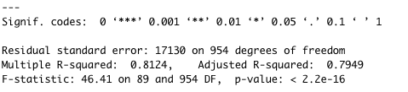
Multiple Linear Regression using R
Fit multiple linear regression model with all the predictor variables for train set.
R – square: 0.812 i.e., 81% of variation in the price of laptops is explained by all the predictor variables.

Slide 14
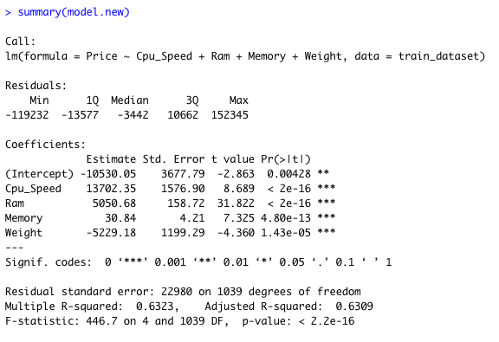
Multiple Linear Regression using R
Fit multiple regression model with the most significant predictor variables for train set.

Slide 15
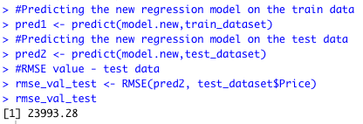
Multiple Linear Regression using R
The obtained values for the new model are:
R2 square: 0.63 i.e., 63%
RMSE value: 23993.28

Slide 16
Regularization
Regularization is a key technique that is employed to prevent overfitting of data, particularly when there is significant variability between the training and testing datasets.
The approach involves introducing a "penalty" term into the best fit obtained from the training dataset, which helps to reduce variance with the testing dataset.
The process involves constraining, regularizing, or shrinking the coefficient estimates in the direction of zero.
Types of regularization: L1 regularization and L2 regularization.

Slide 17
Ridge Regression
Ridge regression is an extension of linear regression in which the loss function is changed to reduce the model's complexity.
Ridge regression is also referred to as L2 regularization
The adjustment is done by adding a parameter for penalty, that is equal to the square of the magnitude of the coefficients.
The tuning parameter lambda can be used to modify the severity of the penalty term.
Before performing ridge regression, it is crucial to determine the appropriate lambda values by performing K-fold Cross Validation.

Slide 18
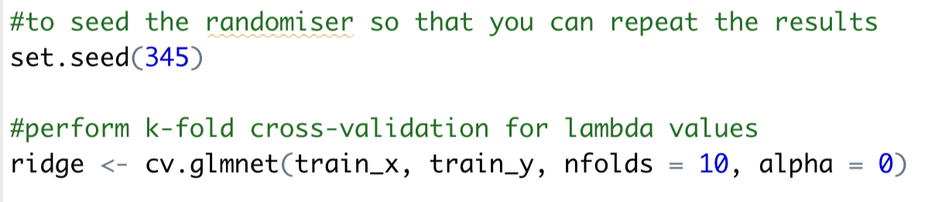
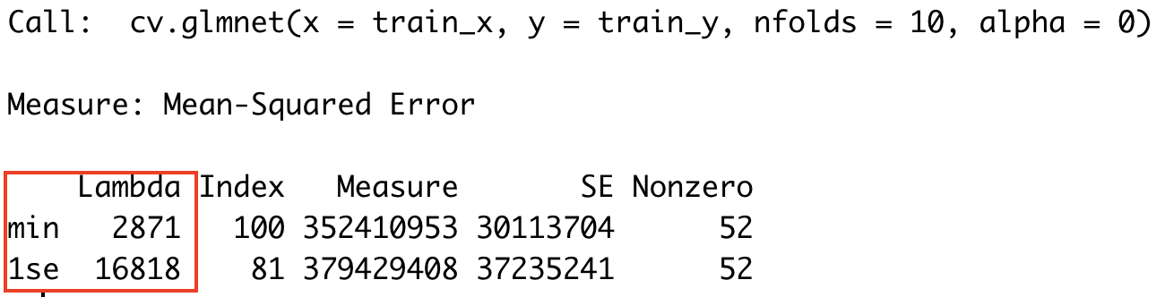
Ridge Regression using R
Initialized the random number generator and performed k-fold cross validation.
Output:
Lambda minimum value is 2871 and maximum lambda value within 1 standard error of minimum lambda is 16818.

Slide 19
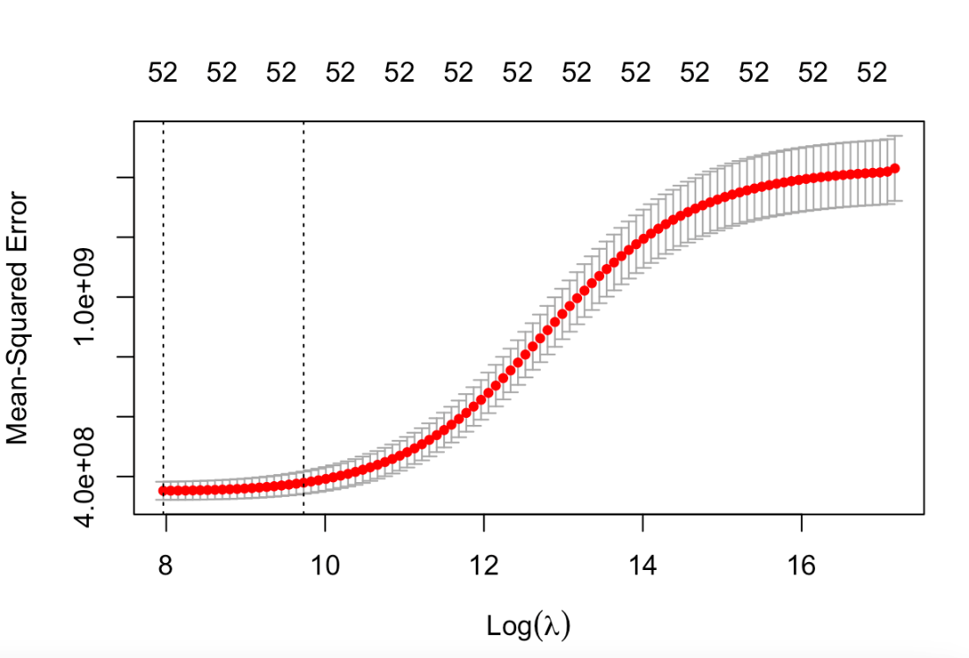
Ridge Regression using R
Plot the results from cross validation.
Minimum log value
of lambda is 7.962.
Maximum log value
of lambda is 9.730

Slide 20
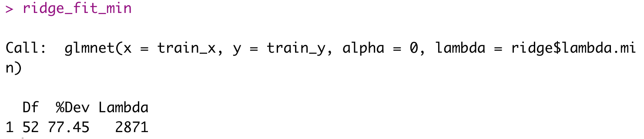
Ridge Regression using R
Fit the ridge regression model with minimum lambda value.
Df value is 52 which is the number of nonzero coefficients, same value we have observed in the plot. The percent (of null) deviance explained (%dev) is 77.45 for the lambda.min.

Slide 21
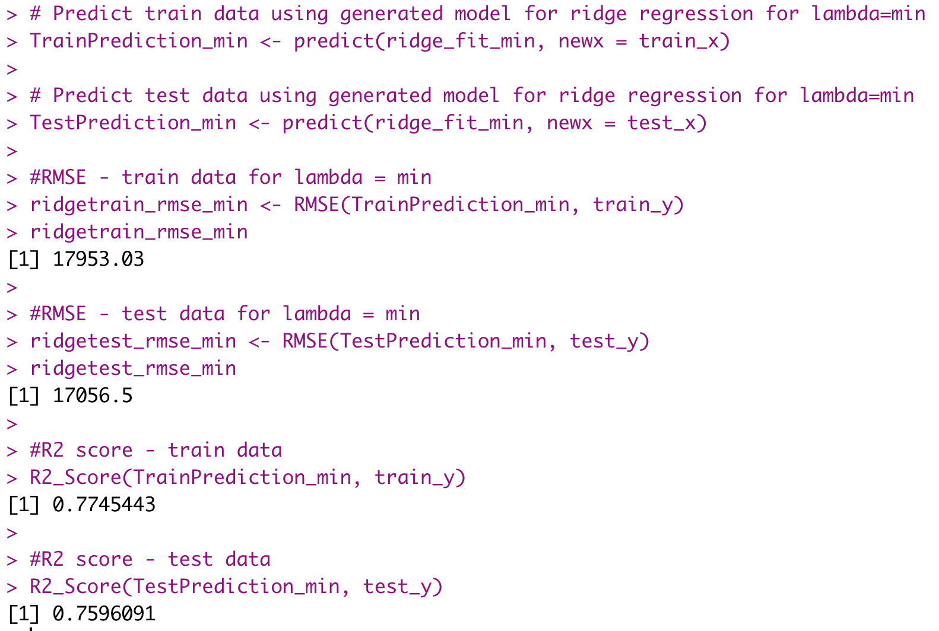
Ridge Regression model performance using R
The 52 independent variables in the ridge model can account for about 76% of variations in the dependent variable "Price".
The RMSE value for train set is greater than test data and is not much different which tells that model is not overfitting.
There is an improvement in the performance compared with linear regression model (R2 63% in LRM that in Ridge is 76%)

Slide 22
LASSO Regularization
The drawback of not being able to actually remove predictors from the equation is overcome by the LASSO regression.
LASSO stands for Least Absolute Shrinkage and Selection Operator.
It performs variable selection.
Before performing lasso regression, it is crucial to determine the appropriate lambda values.
Lambda values can be obtained by performing K-fold Cross Validation.

Slide 23
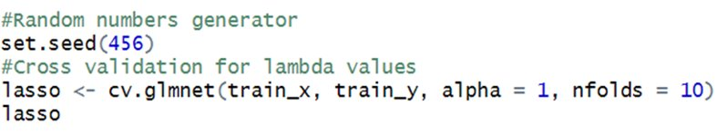
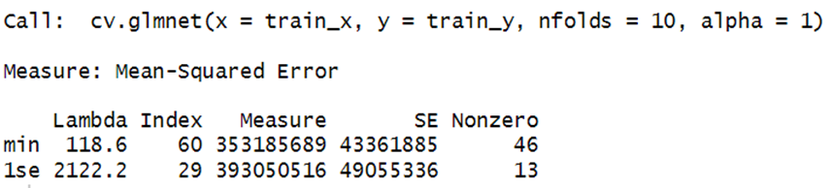
LASSO Regression using R
Initialized the random number generator and performed k-fold cross validation.
Output:
Lambda minimum (lambda.min) value is 118.6
Maximum lambda value within 1 standard error of minimum lambda (lambda.1se) is 2122.2

Slide 24
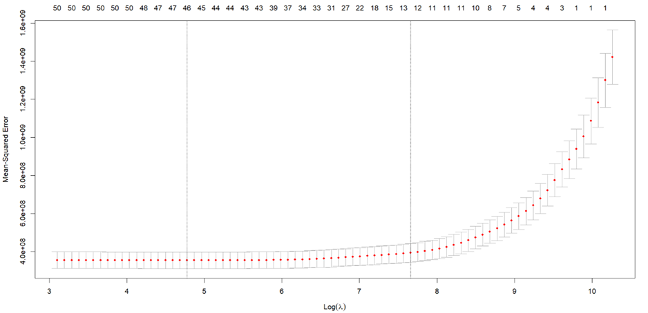
LASSO Regression using R
Plot the results from cross validation.
Minimum log value
of lambda is 4.776.
Maximum log value
of lambda is 7.660.

Slide 25
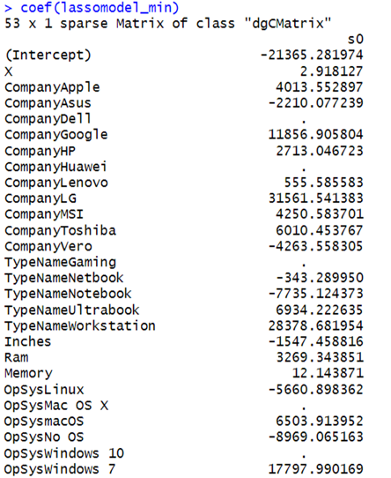
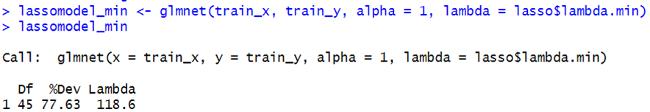
LASSO Regression using R
Fit the lasso regression model with minimum lambda value.
Some of the coefficients of the model
are shrunk to zero.

Slide 26
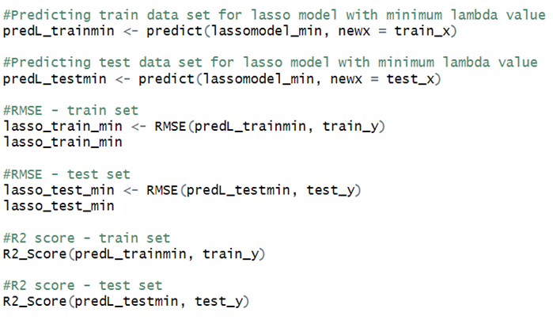
LASSO Regression using R
Predict the 'Price' variable of train and test data.
Calculate RMSE and R2 values.

Slide 27
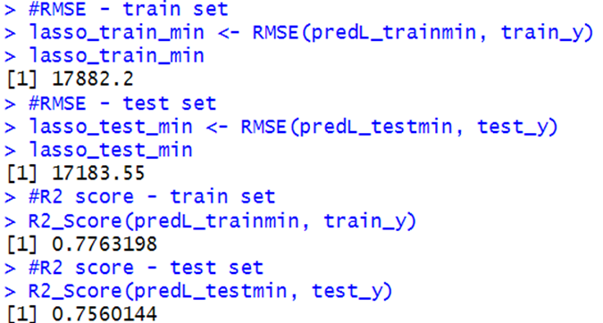
LASSO Regression using R
The obtained values for train set are:
RMSE value – 17882.2.
R2 value – 0.776 i.e., 77%.
The obtained values for test set are:
RMSE value – 17183.55.
R2 value – 0.756 i.e., 75%.

Slide 28
Conclusion
For the laptop price prediction dataset, we used statistical methods and the robust data processing language RStudio in this research. In order to work past the limitations of the linear regression model, we have also learned about the regularization technique.
Below is a summary of how the models performed:
Linear Regression Model: Test set RMSE of 23993.28 and R-square of 63 percent.
Ridge Regression Model: Test set RMSE of 17056.5 and R-square of 76 percent.
Lasso Regression Model: Test set RMSE of 17183.55 and R-square of 75 percent.

Slide 29

Any Questions?

Slide 30
Thank you

